Slide 1
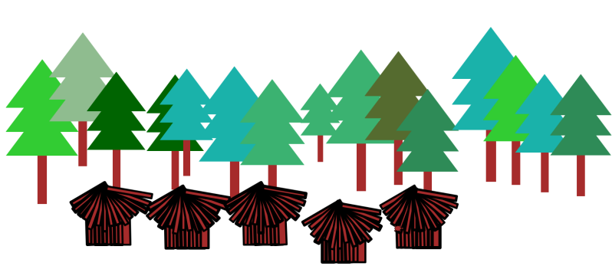
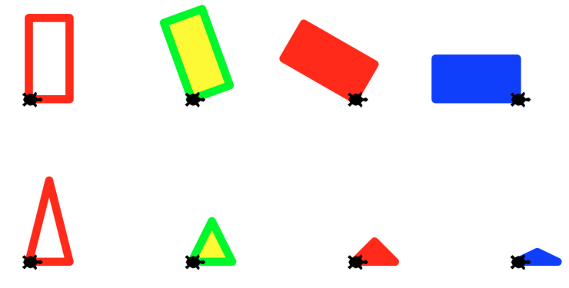

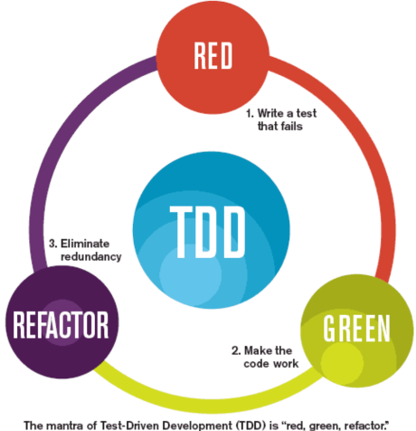


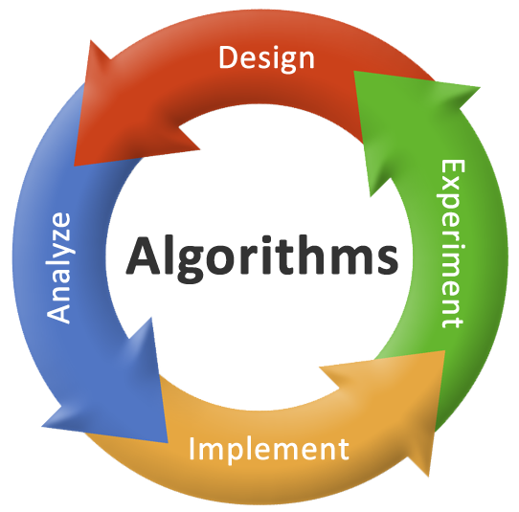
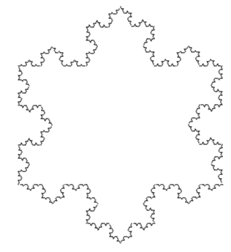

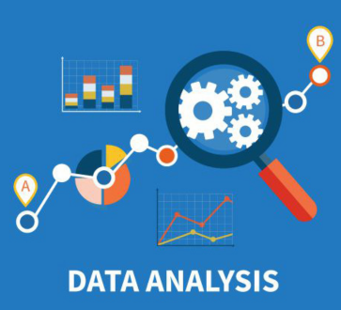

Welcome to CS 8!
Introduction to Computer Science!
https://ucsb-cs8-f17.github.io/

Slide 2
Instructor
Diba Mirza (dimirza@cs.ucsb.edu)
PhD (Computer Engineering, UCSD)
Recently joined the department of Computer Science, UCSB!
Before this: Teaching faculty at UCSD for three years
Office: HFH 1155
Effective next week:
Office hours : Wed: 2pm -3pm Or by appointment in HFH 1155
Lab/office hours: Tue 8am - 9:30am, 11am – noon, Phelps 3526
Notes:
A little about UCSD and how I got into teaching and what I plan to do in this new position. What I have enjoyed seeing is the transformation in my students.
Everyone who is here belongs here unless : you have never taken a programming course (this is an intermediate level course) or if you are simply too advanced!

Slide 3
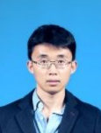
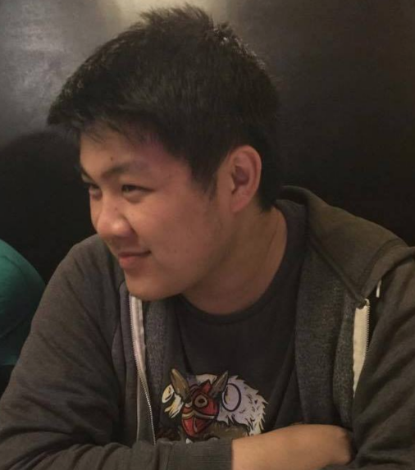
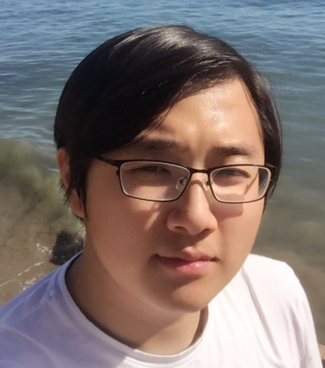
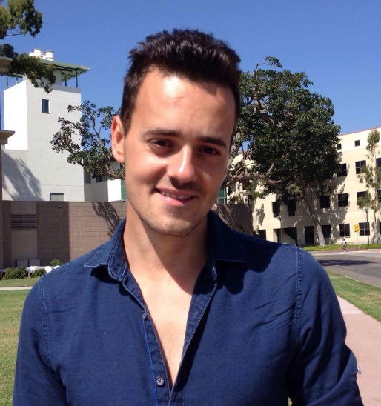
Your TAs
Tim Nguyen
Jian Jin
Yun Zhao
Boyuan Feng
Nemanja (Nick) Stojanovic
Check our class Google calendar for TA office hours:
https://ucsb-cs8-f17.github.io/info/office_hours/

Slide 4
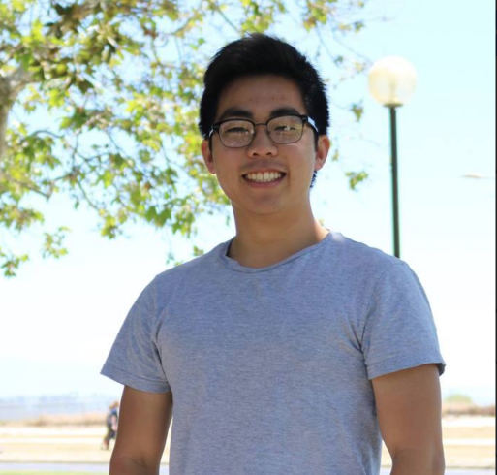
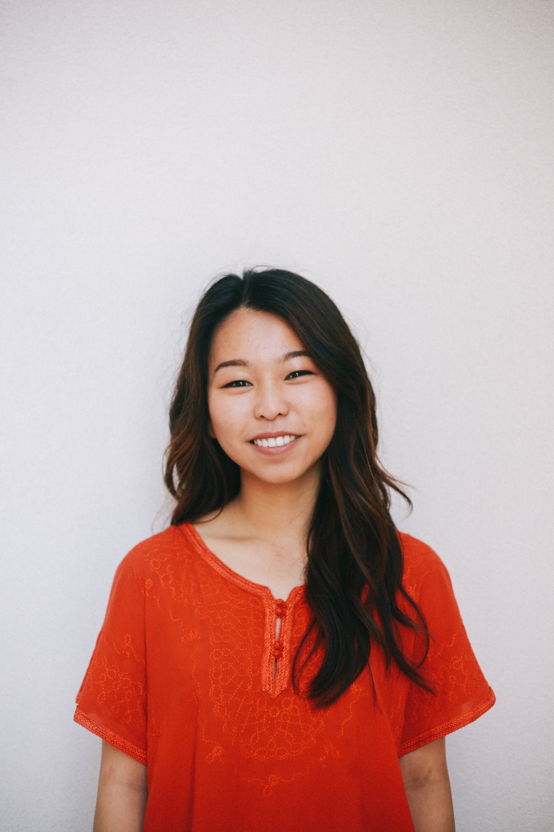
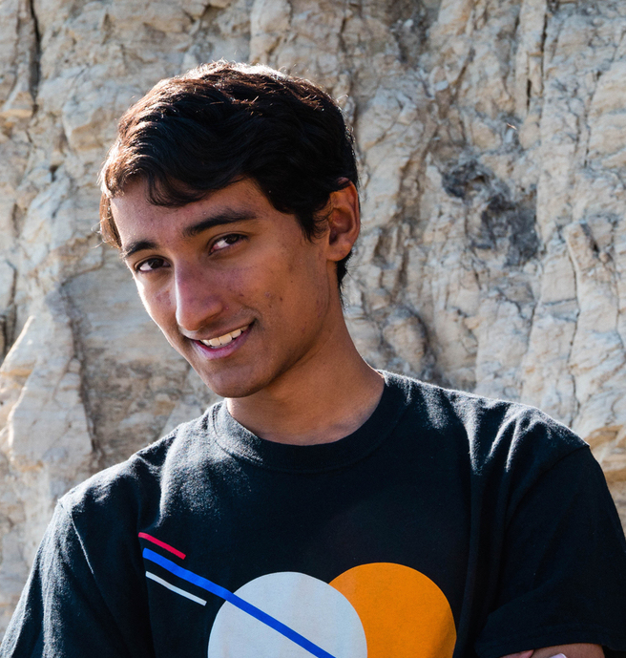
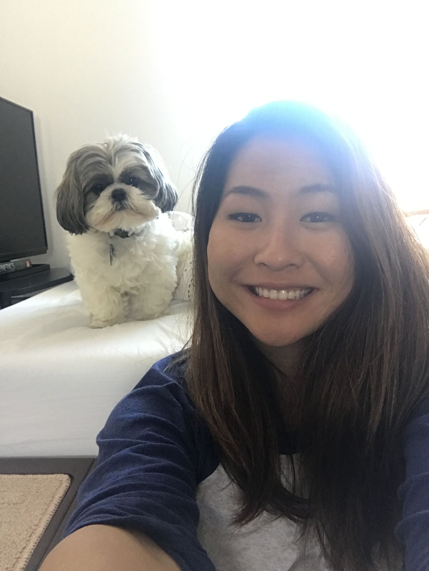
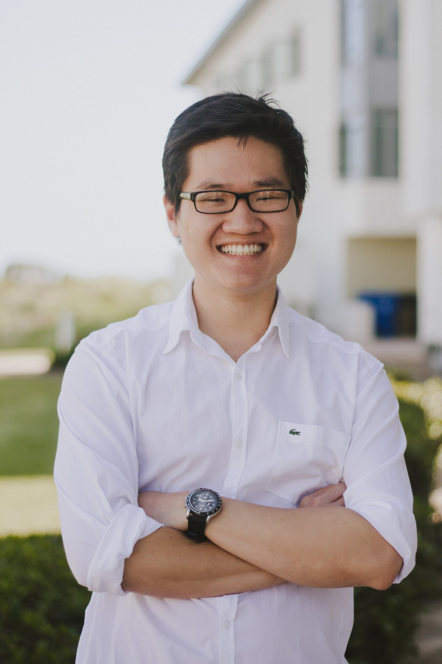
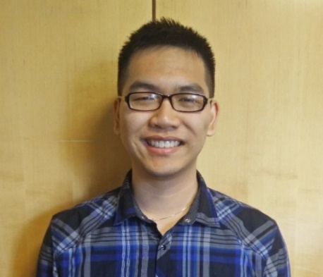
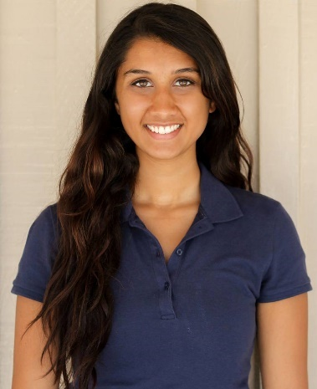
Your tutors
Andrew Huang
Bryanna Phan
Sherry Li
Shreyas Radhakrishnan
Thien Huang
Jimmy Le
Sayali Kakade
Tutors will be available during lab sections: Phelps 3525

Slide 5
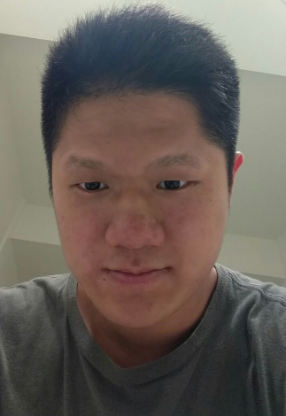
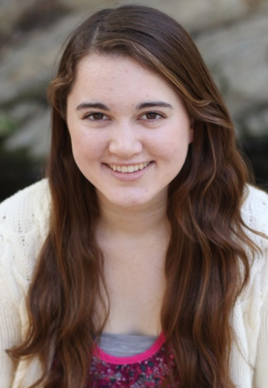
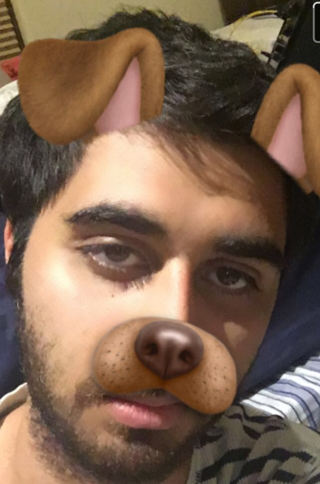
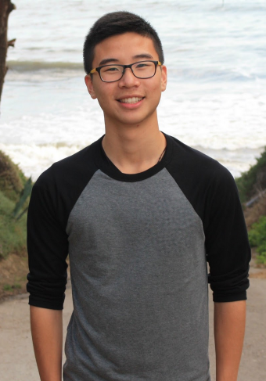
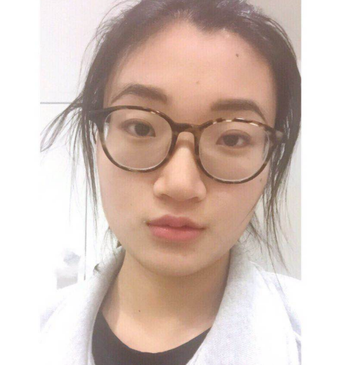
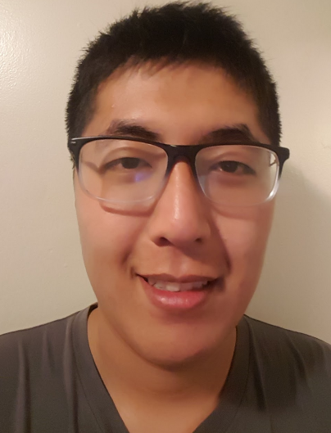
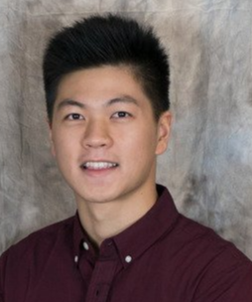
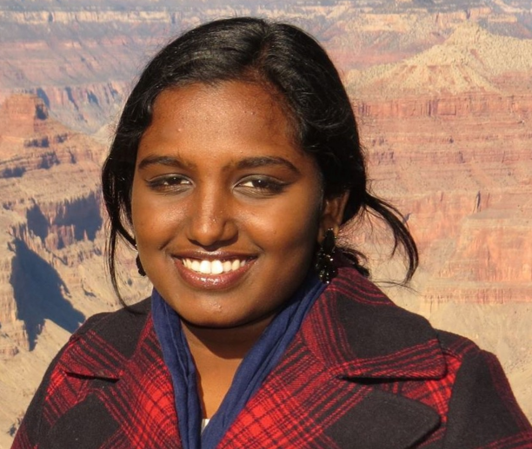
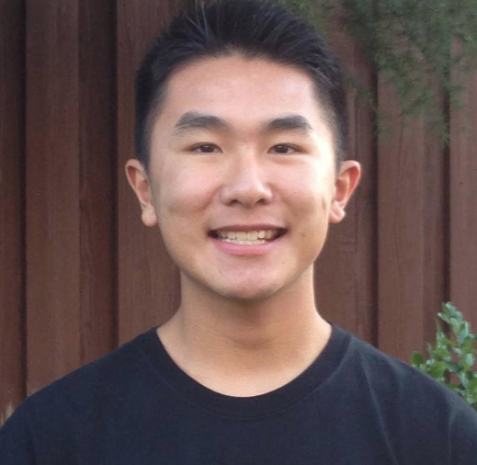
Your tutors…(contd)
Bryan Wu
Taylor McCreary
Navid Shamszadeh
Rey Tang
Madhu Kannan
Koa Sato
Claudia Zheng
Ben Zhu
Andy Chen
Tutors will be available during lab sections: Phelps 3525

Slide 6
About registration for CS8
For those who are not yet registered:
This class is currently FULL!
In fact we are over-enrolled because of which the waitlist is currently closed
If you are an extension student please see me after class

Slide 7
Some stats about this class
Number of students enrolled: 224
Break down by major:
Computer Science: 20% (Majority freshman)
Computer Engineering: 14% (Majority freshman)
Actuarial Sci, Math and Stats: 40% (all levels)
Film &Media, Bio, Physics, PoliSci : 26% (all levels)
We have a diverse class!

Slide 8
About you
Hmm.. if you have programmed before
Hmm.. if you have never programmed before
Hmm.. if you have used Linux/Unix systems before

Slide 9
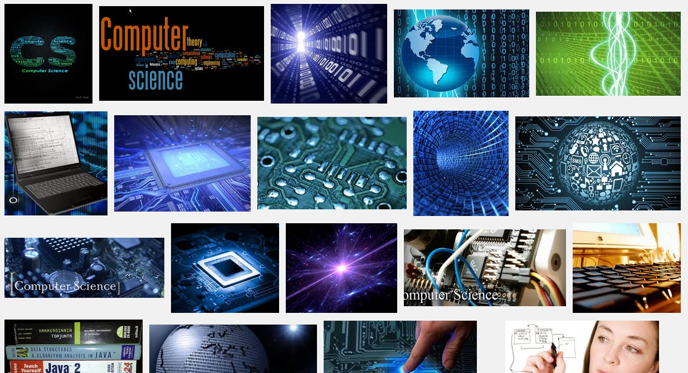
What exactly is Computer Science?
Data * Algorithms * Programming * Binary * Problem Solving Computational Thinking * Hardware * Creativity * Proofs * Logic * …

Slide 10
CS != programming
programming : CS ::
"not equal to"

Slide 11
CS != programming
programming : CS ::
surfing : Santa Barbara
machining : engineering
grammar : literature
Programming
CS
equations : mathematics
a vehicle, not a destination

Slide 12
CS == computing science
Computer Science is…
The science of using and processing
large amounts of information
to automate useful tasks
and learn about the world around us
(using a computer)
"equal to"

Slide 13
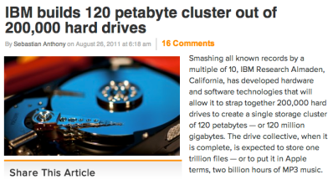
Data, data everywhere…
1 Zettabyte
1.8 ZB
8.0 ZB
800 EB
Data produced each year
logarithmic scale
161 EB
1 Exabyte
5 EB
120 PB
100-years of HD video + audio
1 Petabyte
Human brain's capacity
60 PB
2002
2006
2009
2011
2015
14 PB
1 Petabyte == 1000 TB
1 TB = 1000 GB
References
(2015) 8 ZB: http://www.emc.com/collateral/analyst-reports/idc-extracting-value-from-chaos-ar.pdf
(2002) 5 EB: http://www2.sims.berkeley.edu/research/projects/how-much-info-2003/execsum.htm
(2011) 1.8 ZB: http://www.emc.com/leadership/programs/digital-universe.htm
(life in video) 60 PB: in 4320p resolution, extrapolated from 16MB for 1:21 of 640x480 video (w/sound) – almost certainly a gross overestimate, as sleep can be compressed significantly!
(2009) 800 EB: http://www.emc.com/collateral/analyst-reports/idc-digital-universe-are-you-ready.pdf
(2006) 161 EB: http://www.emc.com/collateral/analyst-reports/expanding-digital-idc-white-paper.pdf
(brain) 14 PB: http://www.quora.com/Neuroscience-1/How-much-data-can-the-human-brain-store

Slide 14
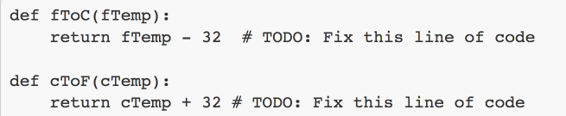
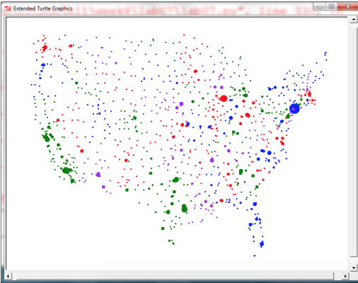

About this course!

Slide 15
Expect to … work hard!
Lectures (attendance is required)
Sections (attendance is required)
8 Labs (to be completed mostly during sections)
2 Projects (Complete outside lab sections)
16 HWs (Read the textbook and complete, practice for exams!)
2 Midterms (during lecture time)
2 Lab exams (during section time)
1 Final exam
In class participation carries credit

Slide 16

Expect it to be…
Thrilling!
And..

Slide 17
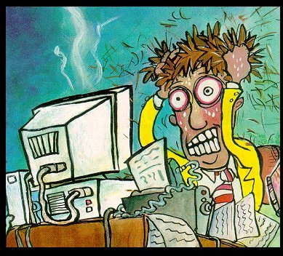
Expect it to be…
Thrilling!
And…
The most frustrating thing you’ve ever done…because computers don’t have a heart!
Notes:
On these two slides, the tutors will tell stories about their experiences.

Slide 18
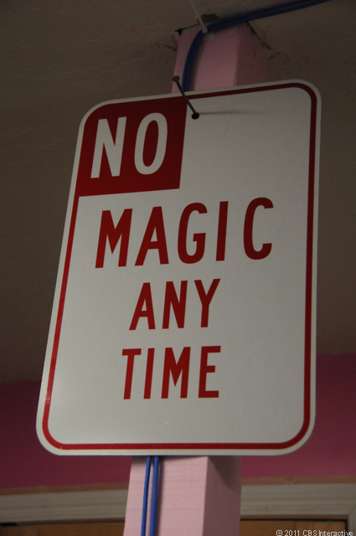
But, there is no magic
You can understand everything. Really.
NEVER guess.

Slide 19
Purpose of lectures
Not a replacement for the book
We will use Peer instruction (will demonstrate shortly)
Find 1-2 students sitting near you. If you don't have any move.
Introduce yourself.
This is your initial PI group (at least for today)
Notes:
a

Slide 20
Do you agree with the following statement?
I believe that there are some people who are “naturally logical thinkers” and some people who are not.
A. Yes
B. No

Slide 21
Do you agree with the following statement?
I believe that people are inherently good at math or they are not. If someone is not inherently good at math, then they probably just won’t do as well in their math classes as someone who is inherently good at math, no matter what they do.
A. Yes
B. No

Slide 22
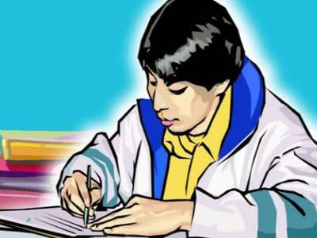

"I'm so good at math!"
Fixed mindset
Natural ability or talent
"I worked really hard and I got it!"
Growth mindset
Practice and hard work
Carol Dweck

Slide 23
"I'm no good at math!"
F
Fixed mindset
"I guess I needed to work harder!"
Growth mindset
Growth mindset interventions have been shown to improve outcomes

Slide 24
Developing a Growth Mindset
Missed an interview question? Practice more! You'll get it next time
Didn't get the job? Think about what could be improved and work at it!
Hard work is something you can control, so take action and practice!

Slide 25
Other words of advice
The quarter moves fast and we have a lot to cover!
Start often, start early
Maintain a calendar to keep track of deadlines
Ask questions, get help
On our class discussion forum (Piazza)
In labs/office hours: tutors, TAs +me!
Practice, practice, practice – code an hour every day

Slide 26
Resources
Course website for details:
https://ucsb-cs8-f17.github.io/
Textbook: “Introduction to Computing Using Python” by Ljubomir Perkovic, 2nd edition
Iclickers: Purchase at the bookstore
Piazza (online discussion forum): https://piazza.com/class/j893pbxd4t06az
TA/tutor instructor lab office hours
Let’s take a look at the website

Slide 27
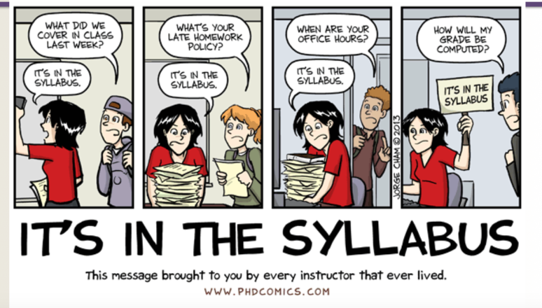
Just in case
Thanks to Ziad Matni and PhD comics!

Slide 28
What you have to do by tomorrow
YOU HAVE A LAB TOMORROW in Phelps 3525!
Log into Piazza and have a look around
Go to the class main website and have a look around: read the syllabus, look at the assignment calendar and the office hours calendar
Complete lab-homework00 (lh00)
This is a “companion-piece” to the first lab
It’s a very simple, very easy homework. DO IT TONIGHT!
Bring the finished hard-copy with you to lab TOMORROW!
Read the lab assignment (lab00) before you go into your lab: BE PREPARED

Slide 29
What YOU have to do before Wed
YOU HAVE ANOTHER LECTURE ON WEDNESDAY!!!
( I will be away at a conference - Professor Richert Wang will fill in for me)
Read Chapter 1
Confirm that you have access to Python, version 3.x
If you want to install on your own computer – see http://www.python.org/ (We will also offer help in labs – bring your laptop)
Available at CSIL and Collaborate labs too
Play with Python at every opportunity
For instance, try out examples from text and lectures

Slide 30
Your TO DOs
Visit Piazza after I add you
Go to the class website
Download and print Lab-Homework0 (lh00) or take a copy today
Do Lab-Homework0 (lh00) TODAY
Read Lab00 TODAY
Do Lab00 TOMORROW (in lab)
Bring your laptop to lab if you want help setting it up
I recommend that you watch this 10 minute video about CS and coding:
https://www.youtube.com/watch?v=IoPx_rSicrM

